Slide 1

Contact Book
Jenn rawlins Nov 13 2017

Slide 2
GOALS
PROJECT APPROACH
ARCHITECTURE OVERVIEW
CODE REVIEW

Slide 3
PROJECT GOALS
POC
Demonstrate client approach
Easy to use minimum viable project
CODE
Demonstrate best practices
Show breadth and depth

Slide 4
PROJECT APPROACH
REVIEW EXISTING
Outlook.live.com - People
Google – Contacts
MVP (Minimum Viable Project)
UI Sketch -> Fields, Layout, Flow
Architecture Design and Technologies
Feature List

Slide 5
DOING NOT DOING
SHOW FULL STACK
UX DESIGN
BASIC TESTING
SIMPLE SQL SCHEMA
SERVER VALIDATION
AUTHENTICATION
UI INTEGRATION TESTS
COMPLEX THEME
MOBILE == DESKTOP
CLIENT VALIDATION

Slide 6
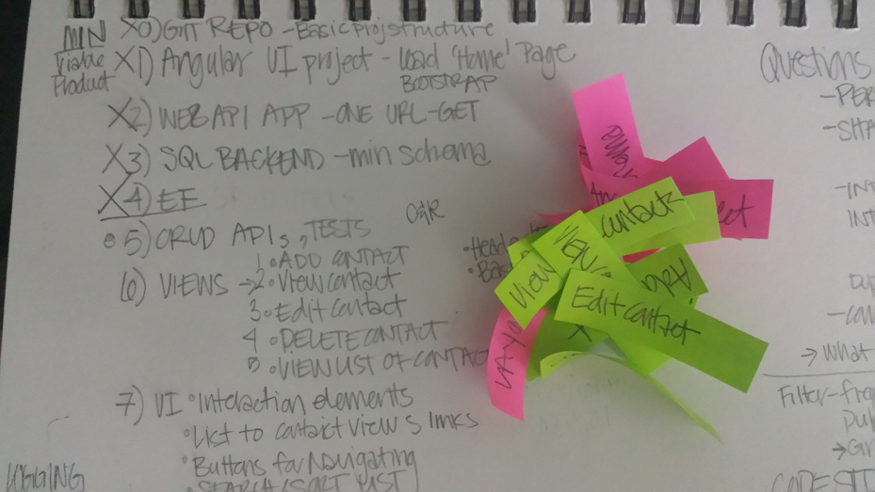
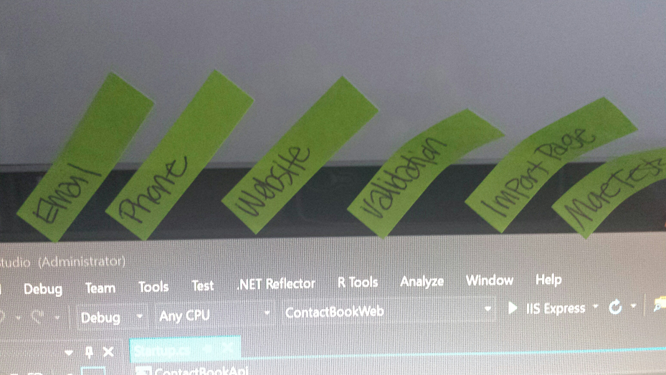
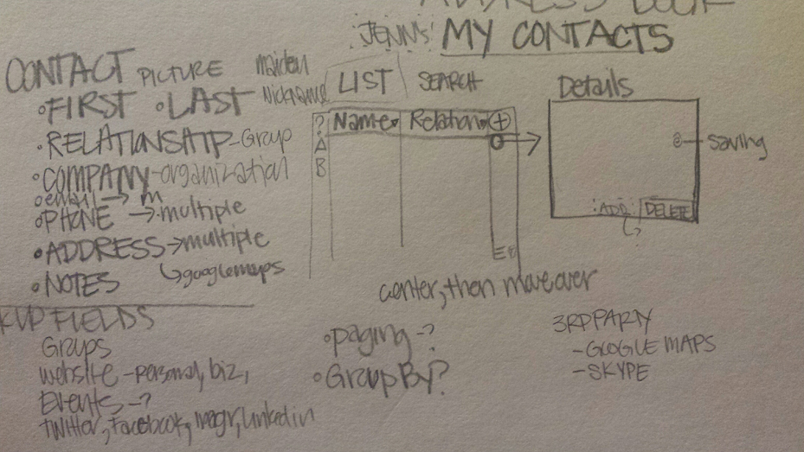
Super fancy project tracking & storyboarding

Slide 7
3 -TIER ARCHITECTURE
ANGULARJS
ASPNETCORE MVC
ASPNETCORE MVC
ENTITY FRAMEWORK
MSSQL

Slide 8
TECHNOLOGY
ANGULARJS
Comfortable, know best practices
Growth: Separate project – replace easily
ASPNETCORE and EF CORE
Newer, but wave of the future
Growth: Docker Container, Azure Web App, Linux
MSSQL
Because I love it
Growth: Azure SQL Database service

Slide 9
DEMO & CODE REVIEW

